Slide 1
IUNotifier Application Project Note – Sprint 2

Slide 2
Agenda
Release Note
Use case diagram
Getting courses information use case
Creating course announcements use case
Development Note
Version control
Sample Java source with refactoring
Sample Java source
Sample Java test source
Test Note
Test case
JUnit test java source
Demo

Slide 3
Release Note

Slide 4
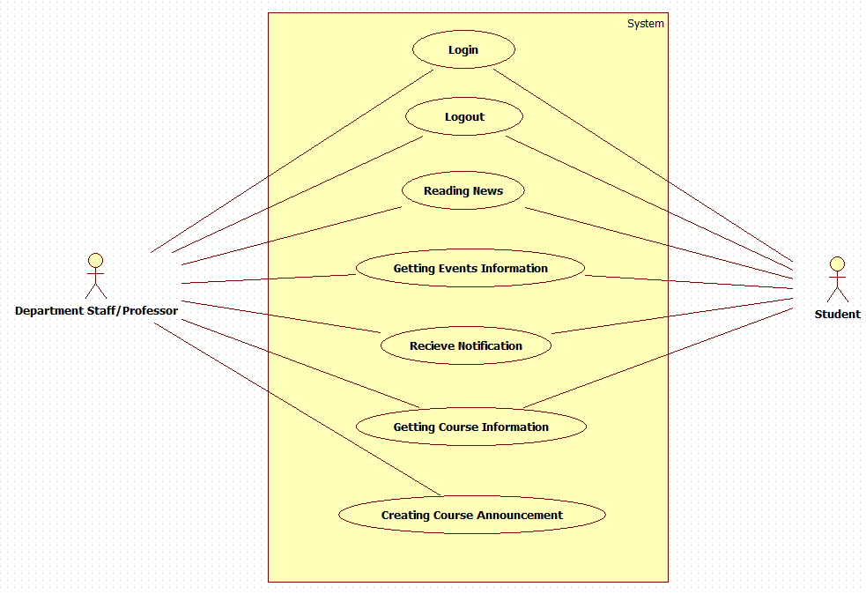
Use case diagram

Slide 5
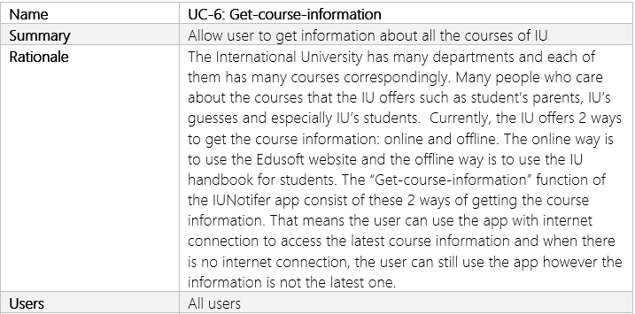
Getting courses information use case

Slide 6
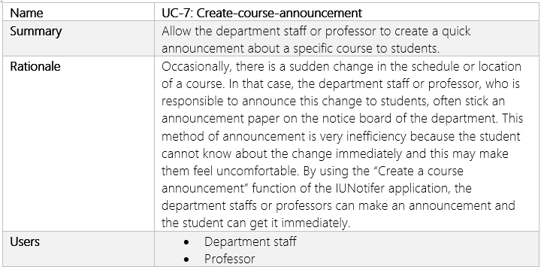
Creating course announcement use case

Slide 7
Development Note

Slide 8
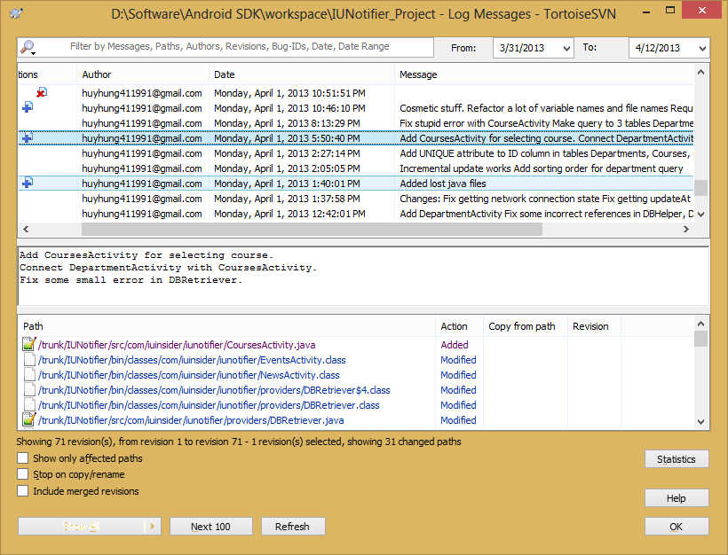
Version control Log message

Slide 9
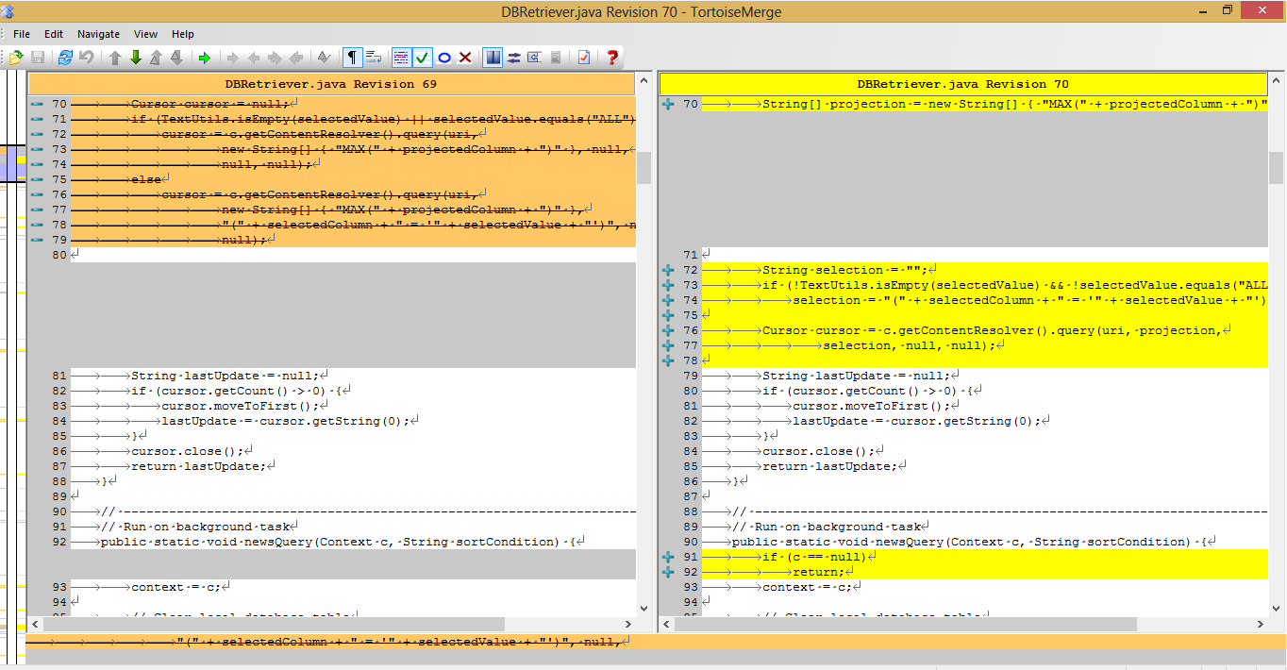
Version control Difference between 2 files

Slide 10
Refactoring
Replace magic number with symbolic constant

Slide 11
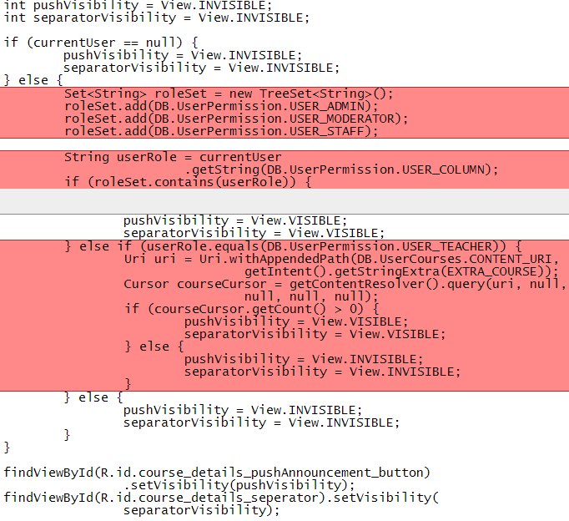
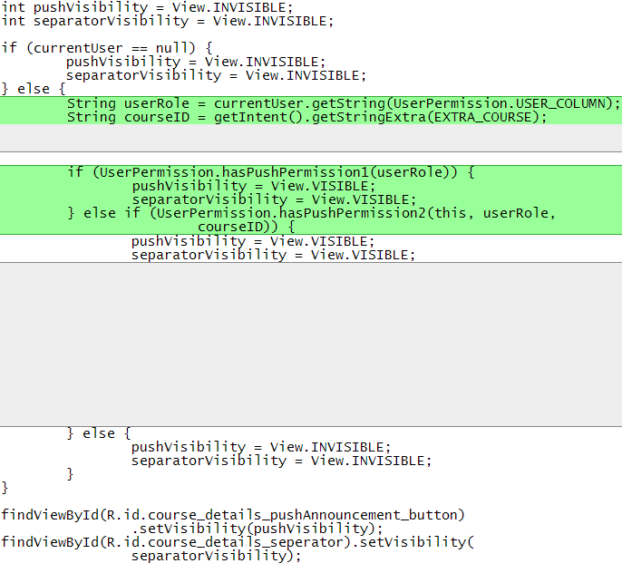
Refactoring
Decompose conditional

Slide 12
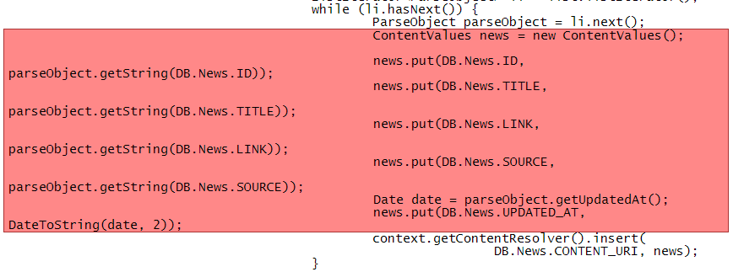
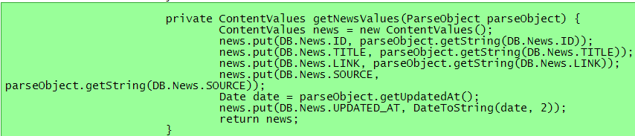
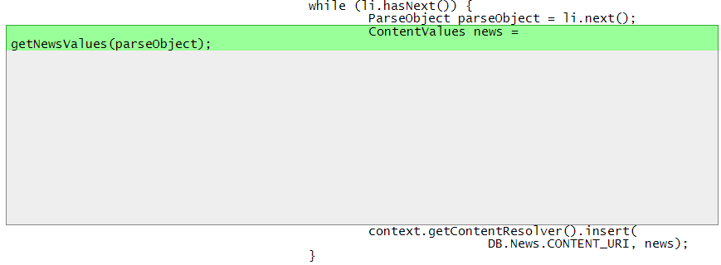
Refactoring
Extract method

Slide 13
Test Note

Slide 14
Test cases
Name | TC-01: Verify that the user can login with a correct username and a correct password
Requirement | FR-01: Login
Preconditions | The username itiu09008 and password 12345 must be available in the database.
Steps | Tap on the “Login” icon. Tap on the “Username” field. Enter itiu09008. Tap on the “Password” field. Enter 12345. Tap the “Sign in” button.
Expected Results | The login form dismisses. The “Login successfully” message displays. The “Login successfully” message dismisses. The color of the login icon changes to blue.

Slide 15
Test cases
Name | TC-02: Verify that the user cannot login with a wrong username and a correct password
Requirement | FR-01: Login
Preconditions | The username abcd is not in the database. The password 12345 must be available in the database.
Steps | Tap on the “Login” icon. Tap on the “Username” field. Enter abcd. Tap on the “Password” field. Enter 12345. Tap the “Sign in” button.
Expected Results | The login form dismisses. The login form displays with the abcd value in the username field and there is five dots appeared in the password field. There is an error message “This username is incorrect” appeared in the username field.

Slide 16
Test cases
Name | TC-05: Verify that the user can logout off their current logging account
Requirement | FR-02: Logout
Preconditions | The user has logged in with the username itiu09008 and password 12345.
Steps | Tap on the “Logout” icon. Tap on the “Yes” button.
Expected Results | The logout-verification windows dismisses. The “Logout successfully” message displays. The “Logout successfully” message dismisses. The color of the login icon changes to white.

Slide 17
Demo

